Slide 1


Introduction To Docker
A little bit of background with plenty of hands-on
Notes:
This presentation will cover Docker fundamentals with the intent to get you into some real-world, hands-on practice as quickly as possible. I want you understand Docker and be able to functionally use Docker with the information in the presentation. If you don’t know a thing about Docker, this is a great place to start. If you know some Docker and want a review, you are in the right place. If you have extensive Docker experience and want to learn more, you won’t find what you’re looking for here although I would love to get your feedback on the material and understand how I can make it better. Let’s get to it!

Slide 2
If you want hands-on practice…
Create a Docker Hub Account
https://hub.docker.com/signup
Download and install Docker Desktop
https://www.docker.com/products/docker-desktop
Download this repo from WWT’s GitHub
https://github.com/wwt/docker-foundations
Install a code editor
https://code.visualstudio.com/Download
Wait a few minutes while we get through a Docker overview
Notes:
Let’s cover the prerequisites for the hands-on activities:
First, you should have a Docker Hub Account. Technically, this isn’t required for what we will cover but having a Docker Hub account is a lot like having a GitHub account; it’s something you are likely to use eventually.
Once you have a Docker Hub Account, download and install Docker Desktop for your computer.
This presentation with all of the presenter notes, all of the files you need for the hands-on tasks, a Docker commands reference, and a README file that explains how to use all of this stuff are in a WWT GitHub repo.
Once you have the appropriate permissions, you can download the repo and have access to everything you need.
Don’t worry if you aren’t familiar with using GitHub; the README file will explain how to download the repo.
Like having a Docker Hub account, having a code editor isn’t required but it will sure make things easier on you than using Notepad.
The screenshots and recordings in this presentation use Visual Studio Code and it seems to be the first choice for the WWT DevNet Study Group.
It’s free, easy to use, and has tons of integrations, including several for Docker, which will help you get started quickly.
That’s a long list of prerequisites although you are very likely to reuse all of these tools in your DevNet studies and, ideally, to make your job easier.
Now we can go through some Docker fundamentals and get to doing actual stuff with Docker.

Slide 3
Part I
Docker Background
Notes:
I learn best when I have my hands on the keyboard so I will make the promise that we will cover just enough of the fundamentals so that you aren’t lost when it’s time for the hands-on exercises, and no more. If you want to dig into the fundamentals more deeply, there are reference links at the end of the presentation which cover every source I used to put all of the slides together. I had to use Docker to really get Docker and my hope is that the combination of the quick background, hands-on exercises, and references work as well for you as they have for me.

Slide 4
Why Does Does Docker Matter?
Helps use fewer resources than virtual machines
Creates portability between different operating systems and clouds
Easy to spin up and spin down, rapidly
Translation – Docker helps organizations move faster, be more agile, and save money
Notes:
Let’s answer the most important question first: why does Docker matter and why should you care? You might be thinking, “isn’t Docker just a different kind of virtualization?” or “I know how to use vSphere, Hyper-V, AWS EC2, or something of the like, what is so special about Docker?”
Put simply, Docker does three things really well:
It improves the scale of conventional virtualization
Makes applications and services highly portable
Turns those applications and services up and down, and scales them vertically and horizontally, in milliseconds; seriously.
The bottom line is every organization wants to be faster, more flexible, and do both of those thing at the lowest possible price. Docker matters, a lot, to every organization we work with so we need to understand Docker in order to be valuable and relevant.
What that really means to us is…don’t be a CONE! Learn something new, enjoy the process, and get some tangible value as a result.

Slide 5
What is Docker?
“Docker is a set of platform as a service products that use OS-level virtualization to deliver software in packages called containers. Containers are isolated from one another and bundle their own software, libraries and configuration files; they can communicate with each other through well-defined channels.”
https://en.wikipedia.org/wiki/Docker_%28software%29
Okay…then what in the heck is a container?
Notes:
In the spirit of what has become a WWT DevNet study group tradition, I included a snippet about Docker from Wikipedia. If you are new to Docker, terms like, “OS-level virtualization” and “containers” may not mean a whole lot to you so let’s start with defining what Containers are and work from there.

Slide 6
What is a Container?
“OS-level virtualization refers to an operating system paradigm in which the kernel allows the existence of multiple isolated user space instances called containers. Programs inside of containers can only see contents and devices assigned to the container.”
https://en.wikipedia.org/wiki/OS-level_virtualization
Confused? Let’s compare virtual machines and containers…
Notes:
Here’s another snippet from Wikipedia that may be as equally unhelpful as the last one. The takeaway here is there is a key difference between containers and virtual machines – containers are virtualized user spaces within a single bare-metal or virtual server.
If the Wikipedia quotes do more to confuse than help you understand Docker and containers, consider the quotes something you can reference later. Let’s do a more detailed comparison of virtual machines and containers to simplify container architecture.

Slide 7


Comparing Virtual Machines and Containers
Virtual Machines ≈ Houses
Containers ≈ Apartments
If all you need is an apartment,
why buy a house?
Fully self-contained
Safeguarded from unwanted guests
Dedicated utilities
Dedicated rooms – kitchen, dining room, family room, living room, etc.
Isolated living spaces
Safeguarded from unwanted guests
Shared utilities
Shared rooms – kitchen/dining room, family/living room etc.)
Notes:
I want to share an analogy that helped me, for the first time, understand what containers actually are.
First, think of a virtual machine like a house
Everything you need, and probably some things you don’t need, come within a dedicated building on your own property.
You have:
Dedicated doors and locks to secure your house.
Dedicated power, water, natural gas, and Internet access.
And dedicated living spaces for specific purposes.
If you only ever use your kitchen, bathroom, and bedroom you have a lot of unused space which requires requires power, HVAC, window coverings…you get the idea.
Think of a container like an apartment
Instead of your own property, you live within your own dedicated space in a shared building.
You also have security by way of doors and locks.
The apartment complex provides shared access to utility services and every apartment has access to those services.
Some of the living spaces may have a shared purpose which means you can more efficiently use space.
There are plenty of reasons to have a house although it doesn’t make sense to buy a house if all you need is an apartment. Virtualization is great and absolutely necessary for many purposes. If, however, you need to run a simple service, say DNS or NTP, it may not make sense to install, secure, and maintain a full operating system, and its many included services which you don’t need for your purpose. This is where containers shine. Let’s compare the architectures of virtual machines and containers so you can see how this works.

Slide 8
Virtual Machine and Container Architecture
Type 1 Virtualization
Type 2 Virtualization
Containerization
Virtual Machines
Containers
App
App
App
App
App
App
Virtual Machines
App
App
App
Bin/Libs
Bin/Libs
Bin/Libs
Bin/Libs
Bin/Libs
Bin/Libs
Bin/Libs
Bin/Libs
Bin/Libs
OS
OS
OS
App
App
App
OS
OS
OS
Bin/Libs
Bin/Libs
Bin/Libs
Hypervisor (Type 2)
Docker Daemon
Docker Desktop Hypervisor (Type 2)
Hypervisor (Type 1)
Host OS
Host OS
Bare Metal
Bare Metal
Bare Metal
Notes:
There are two main types of virtualization:
Type I virtualization is what we see most often in IT operations.
On top of a bare metal server we install a hypervisor, like vSphere, for example.
On top of the hypervisor we can install a bunch of guest operating system instances.
And each of those operating systems has their own applications, binaries, and libraries.
We typically isolate applications to their own virtual machines to avoid resource conflicts.
Type II virtualization is largely the same with the key difference being we install an operating system on the bare metal and run the hypervisor as an application on the host OS.
Examples of type II hypervisors are things like VMware Fusion, KVM, and VirtualBox.
Virtual machines run in the same manner on a type II hypervisor as they do on a type I hypervisor.
In a containerized architecture we typically:
Install an operating system on bare metal and install a containerization platform on the operating system, in our case, that’s Docker.
Containers each have their own isolated copies of binaries and libraries to support applications although containers rely on the host OS for core and kernel services.
Not having to install a new operating system each time there is a need for a new service or feature gives containers a huge scale advantage over virtual machines.
Also, containers don’t boot up and shut down like virtual machines do.
Since the host OS provides kernel services to the container manager, containers can instantiate, start, stop, and restart in milliseconds.
That new DNS or NTP service you want to launch? Fire up a Docker Container and have access to the service instantly instead of waiting on an operating system to install or clone.
Now you need two DNS servers for redundancy? Launch a new Docker Container and you have another service in the blink of an eye.
If your container crashes, it can be back online faster before you realized it crashed.
One more thing to note, Docker relies on many Linux libraries and, therefore, it only runs on Linux.
If you’re thinking, “What about the Docker Desktop that you told me to install on my Mac or Windows computer?”
Docker Desktop runs both the Docker container platform and its own type II hypervisor which boots a Linux OS to run the Docker Daemon.
Anyway, containers don’t replace the need for virtual machines but they definitely show their strengths in many use cases. Let’s talk about some common situations that are great fits for containers but not so great for virtual machines.

Slide 9







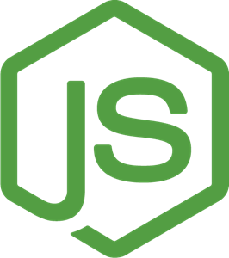
Wins for Docker
Standardized developer environments
Distributed, especially multi-cloud, environments
Micro-services architectures
Cross-OS tool usage
Service C
Service C
for x in range(3):
print(x)
Service B
Service B
Service A
Service A
Notes:
One of the first big wins for Docker is with standardized developer environments
Imagine someone shares a really sweet script or program with you and you try to run it on your computer only to experience the joy of some dependency error
You ask the person that built the script for help and they give you a very insightful reply like, “I don’t know what the problem is because it works just fine on my computer.”
Now I’m not a developer myself so I called my brother that works at a developer for a cloud-native software company that doesn’t use Docker containers for their development environments and asked him if he ever runs into situations where one persons code doesn’t work on someone else’s computer or in a different deployment environment.
His response, and I’ll only change the wording slightly was, “Dude, that sh&t happens 75 times a day; that’s the definition standard development environment around here.”
Someone could certainly build a virtual machine with all of the appropriate tools but distributing and maintaining who knows how many copies of a several-dozen gigabyte virtual machine isn’t going to work. There are too many moving parts, no good way to manage distribution and maintain version control, plus INFOSEC will go nuts when they can’t keep track of an unknown number of virtual machines to patch.
Now imagine this scenario instead; the organization maintains a Docker Image that’s only a couple hundred megabytes in a version-controlled repository with all of their standardized development tools, packages, dependencies, and everything else they need to write code.
Anyone that wants to write code downloads the latest copy of the Docker Image, writes their code and it works on every developer's computer and in every runtime environment.
Nobody has to keep tight control of their package version inventory; they start up a Docker Container with all of the correct tools, every time.
The next win for Docker is with distributed, multi-cloud application deployments.
Let’s say, for example, an organization has an application running in AWS and they want to be able to move or expand it to Azure or even to their private cloud environment in a CoLo whenever there is high demand.
This is tough to orchestrate with virtual machines both because they tend to be big and require conversion when they move from platform to platform.
That’s too bulky and slow for most organizations that need to react on-demand.
By contrast Docker containers are small and highly portable because they have a standard format that will work in any environment.
Containerized applications are, generally, small and lightweight compared to their virtual machine counterparts.
Container orchestration platforms can quickly move services between clouds in a way that is transparent to the applications.
Another win for Docker is with micro-service-based application architecture
Many applications use a monolithic architecture, where multiple services run on the same server.
For example, a front-end web server may handle the delivery of e-commerce, product recommendation, and search services.
If that web server fails, all of those services become unavailable.
However, an application that uses a micro-services architecture, where each independent service runs in a separate Docker container, can tolerate the failure of a single service and still run, even if in a temporarily degraded state.
Maybe the product recommendations don’t work but shoppers can still search for products and place orders.
Micro-services also scale really, really well and a container orchestration platform can both maintain a minimum number of copies for any given service and automatically redeploy, within seconds, containers that fail.
The last win for Docker we will review is a bit simpler but really handy.
Let’s say you need a way to practice Bash commands for, say, an upcoming exam or you want to practice working with iptables.
There are a lot of reasons you might want or need to use a Linux tool on a Mac or Windows PC.
It may take you a few hours to get a Linux virtual machine running on your computer but you can install Docker Desktop and, with an Internet connection and a single command, have a functional copy of Linux online in less than a minute.
You can also run dozens of containers on your computer with a negligible impact to your system resources and create and destroy containers, just about instantly.
Docker really rocks when it comes to this sort of scale and speed.
There are many other wins for Docker, especially when it comes to automated testing. More on that later in the presentation.
So how does Docker actually work? Let’s take a look at the components that make up Docker.

Slide 10
Docker Engine Overview
Client
containers
docker CLI
networks
manages
REST API
manages
Server
images
data volumes
docker daemon
Notes:
The Docker Engine describe the pieces that make Docker what it is and there are three parts:
The Server, also known as the Docker Daemon is the process that is responsible for all of the stuff that Docker actually does.
For example, when you tell Docker to create a container, the Docker Daemon is responsible to carry out that instruction.
All instructions to the Docker Daemon must go through the second piece of the Docker engine, which is the REST API.
Its only job is to allow clients to communicate instructions to the Daemon.
That brings us to the last piece of the Docker Engine, the Docker Client.
A Docker Client can be any system that communicates with the Docker REST API although we typically think of the Docker Client as the Docker CLI.
The Docker CLI is the default client installed with docker and it provides a way to interact with the Docker Daemon, via the REST API.
The Docker CLI manages containers, images, networks, and data volumes and we will use the Docker CLI extensively in the hands-on exercises.
Unlike the Docker Daemon, the Docker Client installs on just about any operating system so you can manage remote instances of Docker whether or not you have the full Docker Engine on your computer.
This diagram is an exact copy of what you will find in the official Docker Documentation and I want to point that out because I think it’s important to know that I didn’t simplify the architecture for someone who new to Docker. All I did was adapt the diagram to build in PowerPoint; that’s all there is to Docker.
Let’s look at an example of how the components of the Docker Engine work together.

Slide 11






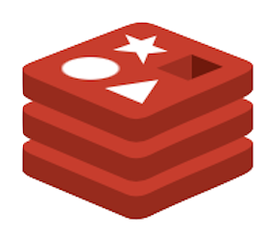
The Docker Architecture
Notes:
Here’s a simple example of how Docker works in a real environment and it is an exact representation of what you will see and do in the hands-on exercises.
First, we have our Docker Client with some examples of the commands we will use in the hands-on exercises
Next, we have a Docker Host which runs the Docker Daemon.
For our hands-on exercises, our computers are our own Docker Hosts and Docker Desktop provides the complete Docker Engine for us.
The Docker host has repositories for both Containers and Images and we will talk about the differences between those two things later on.
For now, there is an image for Ubuntu server already in our Image repository.
We send CLI commands to the Docker Daemon, via the REST API, we tell Docker what we want it to do.
In this case, we tell Docker to create two Ubuntu Containers and the Daemon does just that.
It's common to not have the image we need in our local repository but we don’t need to scour the Internet to look for most Images…for this situation, we have Registries.
Let’s say we want to deploy two Containers with the official Redis database image.
We don’t have that image in our repository yet but we can just tell Docker to deploy the Containers anyway.
Docker will try to find Images locally first and will automatically search the Docker Hub Registry if it doesn’t find the Image we asked for.
You can tell Docker to search other Registries too but, for our learning, we will stick to using the Docker Hub Registry.
A quick note about Docker Hub is that it hosts many official and unofficial Images.
Generally, official images come from OEMs and unofficial images come from people like us.
You can think of Docker Hub like a GitHub for Docker Images.
Anyway, Docker will download the Redis Image from Docker Hub and then create the Containers we asked for.
Now that the Redis Image is in our local repository, any new Redis Containers we deploy will pop up just about instantly.
In the interest of simplicity and transparency, this is another diagram that I pulled straight from Docker’s documentation and adapted for PowerPoint. While there is much more that we can do with Docker, this is a good representation of how the basics work.

Slide 12
Part II
Verify Your Docker Installation
Notes:
That’s pretty much it for the slides, it’s time to get hands-on with Docker.
For each of the hands-on exercises we will go over the commands or instructions that pertain to the task at hand and then show a screen recording of the task. The idea here is you can learn at whichever pace and style suits you best. If you have Docker Desktop installed and want to follow along with your CLI, do it. If you don’t have Docker Desktop installed or if you just want to watch and see what this all looks like, that’s just as good.
All of the screen recordings are built into the presentation so you can review them anytime and they should be a good resource if you try to go through the hands-on exercises and get stuck. Also, all of the commands in the screen recordings with their descriptions are in the GitHub repo, broken out by section, in the docker-commands folder and you can copy and paste commands if you prefer.
Enough talk, let’s do some work with Docker.

Slide 13
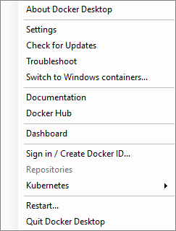
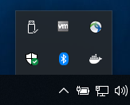
Sign In to Docker Desktop
Open/start Docker Desktop
Log on with your Docker Hub account
krismiller
Notes:
The first step to use Docker is to open and sign in to Docker Desktop. Again, technically, this isn’t required but it’s probably a good idea if you plan to ever use Docker for anything.
Launch the Docker Desktop app, enter your credentials, and sign in. If you don’t see a prompt to sign in, you can access the Docker Desktop menu by:
Clicking on the Docker menu bar icon in the upper-right portion of a Mac desktop.
Or right-clicking on the Docker icon in the notification area at the bottom-right portion of a Windows desktop.
You can verify that you signed in and Docker is running using your Docker Desktop menu.

Slide 14
Verify Your Docker Installation
Open your preferred terminal (bash, PowerShell, zsh, etc.)
Enter the commands:
docker --version
docker info
docker run hello-world
Notes:
The next thing we will do is verify our installation of Docker works correctly. To do that, open your preferred terminal application.
There are a few commands we will run to do this:
docker --version simply displays the Docker version and build information.
docker info shows the version number but also details about:
The number of Containers and Images in the environment.
Information that Docker learns about your computer, as the Docker Host.
And information about the configured Docker Registries.
docker run hello-world will do several things which we will review right after we run the command.
This command is a pretty definitive way to confirm that your installation of Docker works correctly.
Let’s see what these commands do when we run them and feel free to follow along if you like.

Slide 15

Release Year
Release Month
Notes:
A quick note about the screen recordings in this presentation, to make the screen recordings as easy to read as possible, I use a large font in a small terminal window. Sometimes this will make the text output, intended for one line, span many lines. While this isn’t ideal, I feel like having text that is easy to read gets more weight than a perfectly clean output format.
Let’s get started by typing docker --version and pressing your Return or Enter key.
We see the Docker version in our terminal and there a couple of things to note about the version number.
Docker version numbers correspond to the release date of a given version.
The first two digits of the version, before the dot, correspond to the release year and the second two digits ,that appear after the dot, correspond to the release month.
With that information we can determine that this release of Docker is from March of 2019.

Slide 16

Notes:
The next command to run is docker info.
The output will scroll by pretty quickly but we will look at a few things before we move on.
If we pause the scroll-back we can see the configured Docker Registry is at docker.io – this is the Docker Hub Registry
We can also see an Insecure Registry configured with the address 127.0.0.0/8 – this represents the local Registry which Docker will check before it contacts Docker Hub to look for an image.
Next we see some information that Docker learns about your computer like the number of CPUs and memory available to Docker Desktop.
When we scroll all the way to the top we see:
The Docker version
The number of Images
The number of Containers and the state of those containers

Slide 17

Notes:
The last check on our Docker Installation is to run the command docker run hello-world.
This command tells Docker to:
Create and run a new Docker Container based on the Docker Image named hello-world
I’ll pause the playback to show you that Docker first tries to find the Image locally and, when it doesn’t find the Image, downloads the image from the Docker Hub Registry.
Docker creates and runs the Container as soon as the Image downloads.
We can see in the output that Docker tells us, explicitly, that our Docker installation works properly.
We can keep reading to see exactly what Docker did as a result of our command.
The Docker Client sent the Docker Daemon an instruction which caused the Daemon to:
Download the hello-world image from Docker Hub.
Create a new Container from that image which results in the output we see on the screen now.

Slide 18
Part III
Create a Docker Image
Notes:
Now that we verified our Docker installation, let’s talk briefly about Docker Images and build one for ourselves.

Slide 19
Docker Images
Immutable templates for Docker Containers
Built using a Dockerfile with all required binaries, packages, etc.
List your Docker Images with the terminal command:
docker image ls
Notes:
Earlier, I mentioned we would talk about what Docker Images and Containers are and we will start with Images first
Think of Images as templates for what you want Containers to look like.
In the vSphere world, you can build a virtual machine template and use it to create a bunch of identical virtual machines, which all start off as exact clones of the original template.
Docker Images work in about the same way; you build an Image and then create Containers which all start off as exact clones of the Image.
Docker documentation describes Images as immutable although I want to point out you can rebuild Images and add or take away elements as you see fit.
Once you rebuild an Image, that new Image is, likewise, considered immutable.
To build a Docker Image we use a special file called Dockerfile, with no file extension.
The Dockerfile contains instructions which define all of the binaries, packages, scripts, files, and just about anything else you can think of that will comprise the final Image.
We will go into Dockerfile details shortly.
Before we do that though, we will go back to our Docker CLI and have a first look at our Docker Image inventory.
The command that lists all of the Docker Images in our local repository is docker image ls

Slide 20

Notes:
When we look at the output from the docker image ls command we see that, in the instance of Docker Desktop, we have one Image and it’s the hello-world image that download from Docker Hub when we verified our installation.
Now that we know what our local Docker Image inventory looks like, let’s talk about how Dockerfiles work so we can put one together and use it to build an Image.

Slide 21

The Dockerfile
The Docker Image blueprint, read from top to bottom
A text file named “Dockerfile”
Comprised of UPPERCASE instructions
Each instruction represents a layer of the Image
Notes:
When we tell Docker to build an Image, it reads the Dockerfile from top-to-bottom and uses the instructions as a blueprint for the Image.
The Dockerfile is a plain text file and whether or not you capitalize the D is your choice. I like to capitalize the D but it’s purely a matter of preference.
Each instruction in the Docker file must be all uppercase characters or Docker will throw an error during the build process.
If you use Visual Studio Code as your code editor, and you install the Docker Extension, VS Code will warn you if you don’t capitalize your Dockerfile instructions.
We won’t go deeply into Docker Image layers but I will tell you that Docker Images are built one layer at a time with each layer corresponding to a Dockerfile instruction.
If you make a change to the Instruction on line 9 of this Dockerfile and rebuild the Docker image, Docker will leave the layers from lines 2-8 alone, just rebuilding the layer on line 9.
This results in a really quick image rebuild.
If you make a change to the Instruction on line 3 of this Dockerfile and rebuild the image, Docker will leave the layer on line 2 alone but rebuild the layers on lines 3-9.
The point of this is to say the order you place your instructions does, to an extent, matter and it’s best to put the layers which are more likely to change toward the bottom so you don’t have to rebuild layers which are less likely to change.
We will go through the steps to build an Image to using this exact Dockerfile line by line.

Slide 22



The Dockerfile
Dockerfile
FROM python:3.8-alpine
RUN pip install flask
RUN apk add redis
CMD sh
Notes:
Here’s a quick visualization of how a Dockerfile produces a Docker Image. Don’t worry about what the instructions mean because we will go through each in plenty of detail. The idea here is to show you what Docker does with a Dockerfile when you tell it to create an Image.
To start, on the left we have a blank Dockerfile and on the right we have a blank Docker Image.
We start the Dockerfile with an instruction that specifies we want to start our Image using the official Python Image from Docker Hub and we want that Python image to use the Alpine Linux operating system.
If you're not familiar with Alpine Linux, just know it is an extremely lightweight version of Linux designed to be as small and efficient of an operating system as possible.
At the time I put this slide together, I downloaded the latest release of Alpine from Docker hub and it is all of 5.59 megabytes...not bad for an OS.
Next, since we will use Alpine Linux with Python installed, we can use PIP to install Python packages.
Flask is a lightweight web server application written for Python.
You don't need to know that to use Docker but it's worth pointing out since it's on the screen.
Next, we use APK, which the package manger for Alpine, to install the Redis database.
Again, no need to know what Redis is but for the sake of conversation, it's a database designed for containerized applications.
The last thing we do is tell Docker what to do when we run the Container.
In this case, it's pretty simple, we tell Docker to start a shell session which will drop us into the CLI of the Container.
If any or all of that is confusing, hang tight because you about to get hands-on experience with all of this and it will make more sense. This is just an example so you understand that the goal of building a Dockerfile is to create the framework or blueprint for the Image we want.

Slide 23

Notes:
It’s time to get started with a Dockerfile. If you don’t already have it open, launch Visual Studio Code, or which ever code editor you want to use.
In the VS Code Welcome tab, click the Open folder… link so we can setup a folder to host our Dockerfile.
I think it’s a good idea to create a new directory for this project and, in this case, I create a folder called code in my home directory.
You can open any folder you like, it really doesn’t matter. This is just a suggestion.
Once you navigate to the folder you want to open, click the Open button; VS Code will show you a file navigator on the left of the screen.
Move your mouse over the folder you opened to reveal the icon to create a new file.
Click on the icon, type Dockerfile, and press your Return or Enter key.
VS Code will open your file in a new tab and your cursor should be ready for you to type.
Start your Dockerfile with a comment by entering a hash symbol and typing a description for your Docker Image.
I recommend saving your file frequently, just as a good practice.
If you are new to VS code, an unsaved file will have a dot icon to the right of the file name.
We are setup to start our Dockerfile now so let’s start adding instructions and make this thing real.

Slide 24
The FROM Instruction
Always the first instruction, specifies base OS image
Base image index available on https://hub.docker.com
Formatted using tags
FROM python:3.8-alpine
FROM instruction
Alpine Linux OS
Python official image
Python version 3.8
https://hub.docker.com/_/python
Notes:
We start with the FROM instruction because it must be the first instruction in a Dockerfile.
While it is possible to build your base Image from scratch, it is most common to use an existing, official Image from Docker Hub.
Just like it’s possible to build your own version of Linux, it’s probably less common to do that than it is to download an install an existing distribution.
After we type FROM, we specify the base Image name using tags.
I won’t deep-dive on tags, I will just say that the exact format you need to type for every single tag is in Docker Hub, on the main page for whichever Image you want to use.
Here’s the FROM instruction for our Dockerfile so let’s take a quick look at each component.
First, we have the FROM Instruction itself.
Next, we specify the tag for the official Python base image followed by a colon.
The 3.8 tells Docker that we want Python version 3.8, that part is pretty straightforward.
Last, we use a dash followed by the specific OS that we want.
There are several OS options and each official Image will show you the tags for those options.
If you want to look at all of the tags for the Official Python Docker Image, here is the link.
By the way, that’s an underscore between the two forward slashes.
Let’s type that instruction into our Dockerfile.

Slide 25

Notes:
We'll switch back to VS Code and type in the exact instruction we just reviewed and save the Dockerfile.
That's one instruction done...on to the next one.

Slide 26
The RUN Instruction
Runs any command/script available in the OS
Create directories (mkdir), install packages (pip, apk, yum, etc.), run scripts, etc.
RUN mkdir /app
RUN instruction
Shell command
RUN pip install --upgrade pip
RUN pip install flask
RUN apk add redis
Notes:
The RUN instruction lets us run any command or script which is available in the OS Image.
Think of the RUN instruction as a way to type commands directly into the shell of a Linux OS.
You can do things like:
Create directories.
Install packages.
Run scripts.
And just about anything else you can think of.
Here’s one of the RUN instructions for our Dockerfile.
We have the RUN instruction itself followed by the sell command to create a directory called app at the root of our file system.
That’s it, not much to it.
Just to add some color to our Dockerfile, there are a few extra RUN instructions:
Next up, we will run this PIP command which upgrades PIP to the latest version.
After that, one more PIP command to install the Flask web server.
We will finish up with an APK command to install the Redis database.
One note on RUN instructions, in many cases it is best to combine all of these commands into a single RUN instruction.
Each of these RUN instructions creates a separate Image layer which may or may not be a good idea, depending on the situation.
That’s just to point out that you can combine several commands into a single RUN instruction if it makes sense.
Let’s type these instructions into our Dockerfile.

Slide 27

Notes:
Back in VS code we can enter each of our RUN instructions on a separate line. Safe the Dockerfile when you are done.
On to the next instruction…

Slide 28
The WORKDIR Instruction
Sets the working directory for other instructions (RUN, COPY, etc.)
Accepts absolute or relative paths (/home/folder1, folder1)
Will be the result of the pwd command in the Container
WORKDIR /app
WORKDIR instruction
Working directory
WORKDIR bin
WORKDIR resources
bash$
pwd
returns
/app/bin/resources
Notes:
The WORKDIR instruction sets the directory that any subsequent instructions will run in.
Think of the WORKDIR instruction like the cd command in a Windows, Mac, or Linux terminal; it changes the directory you run your next command in.
The WORKDIR instruction accepts either absolute or relative paths and you can issue as many WORKDIR instructions as you need.
One WORKDIR instruction can change you to a certain directory so you can run a command and another WORKDIR instruction can put you in a different directory for a different command.
If you were to issue a RUN instruction with the shell command pwd after you issue a WORKDIR instruction, the output of the pwd command would be whatever your WORKDIR is.
After you type the WORKDIR instruction, type the relative or absolute path to the working directory that you want to set and you’re done.
We will just use one WORKDIR instruction in our Dockerfile but, if we were to use several WORKDIR instructions with relative paths and then issue a pwd command, the result of the pwd command would be, in this case, /app/bin/resources.
Let’s set the WORKDIR these instructions in our Dockerfile.

Slide 29

Notes:
In VS code, enter the WORKDIR instruction just like this and save your Dockerfile.
Our Dockerfile is taking shape now so let’s keep it up.

Slide 30
The COPY Instruction
Copies files or directories to the Image
Accepts absolute or relative paths (/home/folder1, folder1)
Accepts wildcard characters (*.txt)
COPY my_script.py myscript.py
COPY instruction
source
destination
COPY files_dir /home/files_dir
COPY . .
Notes:
The COPY instruction does about what you think it might do; it copies files or directories from the Docker Host to the Image during the build process.
This is an easy way to get files into your Image and make scripts or other tools available when you create Containers from your Image.
You can use both absolute and relative paths for both the source and destination arguments.
You can also use wildcard characters to easily copy multiple files and you can issue multiple COPY instructions if you need to.
When you enter the COPY instruction, just specify the source and destination paths and you’re done.
In the case of this COPY instruction, we copy a Python script named my_script.py to whatever the working directory is that we have set for our Image.
Here are a couple of other examples of the COPY instruction that we won’t use in our Dockerfile but are good for reference:
This COPY instruction copies a directory from the Docker Host called files_dir to the Image destination /home/files_dir.
Since we specify an absolute path for the destination, Docker will copy the file to that path and not the working directory.
This last COPY instruction copies all files in the working directory of our Dockerhost to the working directory of the Image.
Now let’s add a COPY instructions to our Dockerfile.

Slide 31

Notes:
In VS code, enter the COPY instruction and use my_script.py as both the source and destination.
The my_script.py file is part of the GitHub repository you downloaded.
Once you save your Dockerfile we can keep rolling.

Slide 32
The EXPOSE Instruction
Informs Docker that the Container listens on a specific port at runtime
Does NOT actually publish the port, functions as documentation
Info from the Image builder to the person who runs the Container
EXPOSE 8080
EXPOSE instruction
port (TCP is the default)
EXPOSE 8080/tcp
EXPOSE 8080/udp
Notes:
The EXPOSE instruction is cosmetic, to a degree.
It tells the Docker Daemon that a Container is supposed to listen on a certain port or ports at runtime.
The EXPOSE instruction doesn’t actually publish a port and tell the container to listen on that port.
Rather, it’s a way for the person that builds the image to tell anyone who uses the Image, which port or ports to publish to their Containers.
The syntax for the EXPOSE instruction is pretty simple:
First is the EXPOSE instruction itself and next is the port number.
TCP is the default protocol but you can specify TCP or UDP like this.
You can have as many EXPOSE instructions as you need for your specific use cases.
Let’s add an EXPOSE instruction to our Dockerfile.

Slide 33
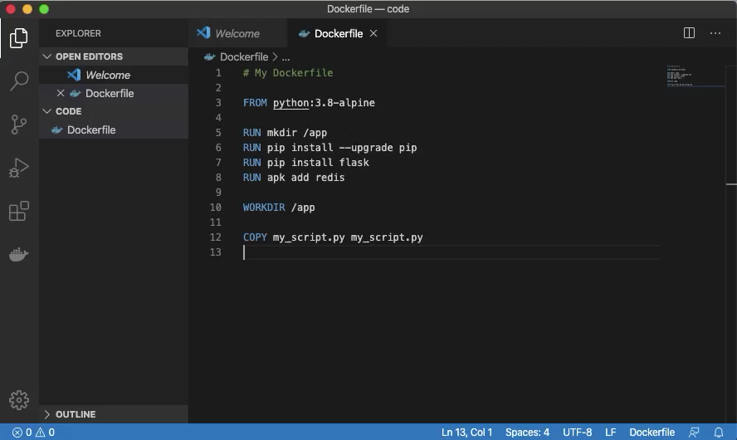
Notes:
In VS code, enter the EXPOSE instruction with port 8080 and save the Dockerfile.
We are just about done with the Dockerfile…on to the penultimate instruction.

Slide 34
The LABEL Instruction
Adds metadata to the Image
Denoted in key-value pairs (maintainer="Kris Miller")
Dockerfiles support single and multi-line LABEL instructions
LABEL maintainer="Kris Miller <kris.miller@acme.com>"
LABEL instruction
key
value
LABEL version="1.0" \
description= "Web Application Image"
Notes:
The LABEL instruction is a way to add metadata to an Image as a form of documentation.
You can add as many LABEL instructions as you like but it’s more typical to use multiple key-value pairs within one LABEL instruction with multiline syntax.
The syntax for the LABEL instruction looks like this:
After the LABEL instruction, add a key-value pair, separated by an equals sign, and the value wrapped in quotation marks.
This LABEL instruction lets people know who created the Image.
Here’s an example of a multiline LABEL instruction:
You can use a backslash character at the end of a line and add another key-value pair on the next line.
It’s good practice to indent after the first line so the keys line up and make the Dockerfile as readable as possible.
Let’s add a LABEL instruction to our Dockerfile now.

Slide 35
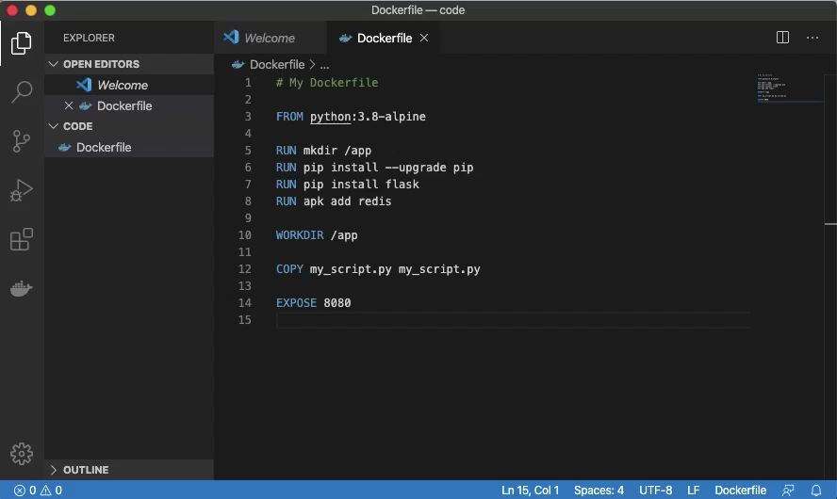
Notes:
In VS code, enter the LABEL instruction and set the maintainer key to your name and email address.
Save the Dockerfile as soon as you’re done and let’s move to the last instruction for our Dockerfile.

Slide 36
The CMD Instruction
Specifies the executable for Containers to run at startup (sh, flask, etc.)
Only one CMD instruction allowed
The Final Dockerfile instruction
CMD sh
CMD instruction
executable
CMD echo "Hello World"
CMD flask run --host=0.0.0.0 --port=5000
Notes:
The CMD instruction tells Containers what to do when they start.
For example:
You might issue a sh command to start a shell session.
Or, you might issue a flask command to start the Flask web server.
Whatever you do with the CMD instruction, just know you need to have one and only one CMD instruction and it must be the final Dockerfile instruction.
In our Dockerfile, we have a CMD instruction which executes the sh command to start a shell session.
This means we will have shell access to a Container as soon as we start and attach to it.
If your not sure what that means, don’t sweat because you will soon see for yourself exactly how this works.
Here’s are a couple of other examples of CMD instructions:
This CMD instruction will print Hello World to the Docker Host terminal.
And this CMD instruction starts a Flask web server with arguments to listen to TCP port on any IP address .
Let’s finish off our Dockerfile with a CMD instruction.

Slide 37
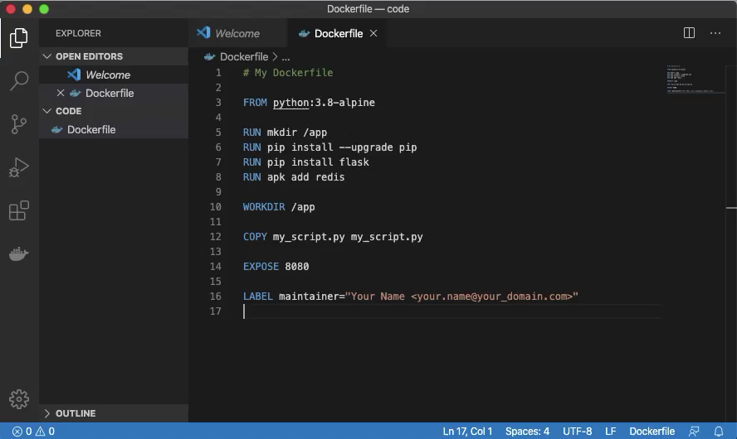
Notes:
In VS code, enter the CMD instruction with an executable argument of sh.
Save the Dockerfile and take a victory lap because it’s done and we are ready to build the Image.

Slide 38
Build Docker Images
You have a complete Dockerfile, let’s do something with it!
Open your terminal and switch to the directory with your Dockerfile
For example, cd ~/code
Create a Docker Image with either of these commands:
docker build -t my_image .
docker image build -t my_image .
List your Docker Images with the terminal command:
docker image ls
Don’t forget the dot!
Notes:
Now that we have a complete Dockerfile, we are ready to build a Docker Image.
We build the Docker Image from the Docker CLI so open your terminal and make sure your working directory is the directory with your Dockerfile in it.
To build your Docker Image, use one of these two commands.
docker build or docker image build
Both commands do the exact same thing and Docker supports either syntax so neither is more correct than the other.
The -t flag is required and you follow it with the tag or name for the image.
The last part of the build command is the path to the Dockerfile; the blueprint for the Docker Image.
If your terminal working directory contains the Dockerfile, use a dot for the path.
Otherwise, you can specify an absolute or relative path to the Dockerfile instead.
After the Image builds, use the command docker image ls to see the fruit of your labor.

Slide 39
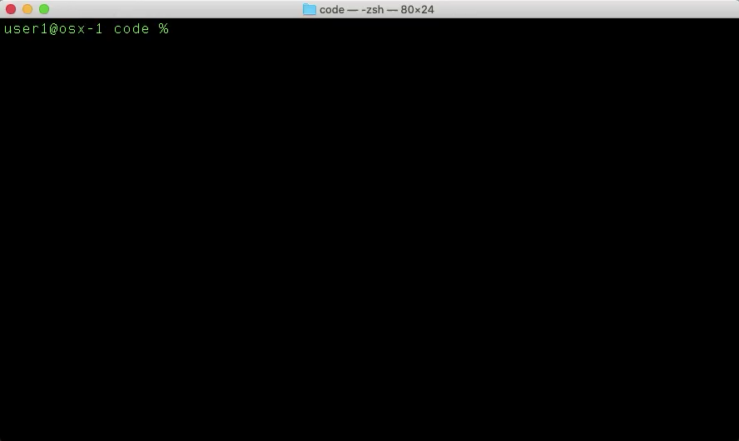
Notes:
Let’s build the Docker Image from our terminal and watch what happens.
Docker will build a layer for each instruction.
We see Docker pull the base image from Docker Hub.
Next, Docker executes all of the RUN instructions we specified which will take a few seconds as several of the instructions require downloads and installations.
Docker sets the WORKDIR.
Cpies the my_script.py file to the Image.
Runs the EXPOSE instruction.
Adds a LABEL to the Image.
And sets the sh command to run as soon as we launch a container.
When the Image build is done, issue the docker image ls and notice we have not two but three images.
We still have the Hello-World image.
We have the Python:3.8-alpine image that downloaded from Docker Hub.
And we have the my_image Image that we just made.

Slide 40
Remove Docker Images
List your Docker Images with the terminal command:
docker image ls
Remove your Docker Image with either of these commands:
docker image rm my_image
docker image rm image_id (docker image rm 6d37630d7e9b)
In some cases, you need to use the -f option to force removal:
docker image rm -f my_image
List your Docker Images again to confirm the delete:
docker image ls
Notes:
As great as it is to be able to build Images, we need to be able to remove Images too.
To do that, start with a docker image ls, so we can get the details we need to remove an Image.
Next, use the docker image rm command with either the image tag, my_image in this case.
You can also use the image_id instead of the tag, if you like.
Sometimes you might need to use the -f flag to force an Image to delete.
After you remove the image, check your Image repository with the docker image ls command.
Let’s run those commands in the terminal to see how it looks.

Slide 41

Notes:
First, we see our list of images again, with the docker image ls command.
Next issue the docker image rm my_image command to delete the image we created.
One more time, run the docker image ls command and we no longer see our Image in the local repository.

Slide 42
Docker Image Challenge
Rebuild your Docker Image
What is different between the first and second builds?
Notes:
You probably guessed that we will need that Image to create some actual Containers with so here’s a challenge for you:
Rebuild the Docker Image using the commands we just used and see if you notice any difference between the first and second builds.
Let’s give it a try.

Slide 43

Notes:
Just like the first time, use the docker image build command with a tag of my_image and a path of dot.
Watch the Image build again and notice how quickly the FROM instruction runs this time.
Any idea why this happens so quickly?
It’s because Docker is smart enough to check its local repository and see that it already has a copy of the python:3.8-alpine image.
Docker doesn’t have to download that Image from Docker Hub again.
Otherwise, this build process will be identical to the first build.
Once the build is done, use the docker image ls to see your new Image.

Slide 44
Part IV
Run Docker Containers
Notes:
Now that we have an Image, we can use it to create Containers so let’s jump right in.

Slide 45
Docker Containers
Ephemeral instances of Docker Images
List your Docker Containers with the terminal command:
docker container ls -a
Notes:
Just to review:
Docker Containers are instances of our Docker Images and their lifespan, unlike most virtual machines, is often very short.
There’s usually no reason to try to recover a malfunctioning Container because you can likely just destroy it and start a new Container to take its place.
In fact, Docker can do that for you automatically although that function is often left to Container orchestration platforms like Kubernetes and OpenShift.
Before we create a Docker Container we’ll take a quick look at our Container inventory, just for a starting point.
The command to list all containers is docker container ls -a
The -a is important because, if you omit the -a, Docker will only show you running containers.
Of course, leave out the -a if you only want to see your running containers.
Let’s run that command in our terminal so we can see what it looks like.

Slide 46
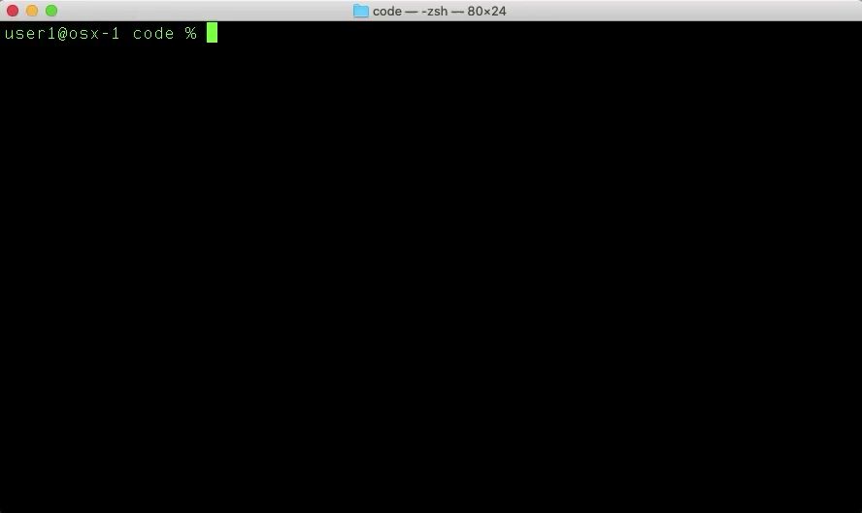
Notes:
Just like we expect, we don’t have any Containers in our inventory so find a way to change that.

Slide 47
Docker Container Command Flags
Several command flags are common to run a Docker Container
docker container run [FLAGS] image_name
-i – interactive mode
-t – create a pseudo-TTY session
--name my_container – assign a name to the Container
-v host_dir:container_dir – mount a volume to the Container
-p host_port:container_port – publish a Container port to the host
-d – run the Container in the background (detached mode)
--rm – automatically remove the Container on exit
image_name – specify the source Image name for the Container
Notes:
While the Docker CLI doesn’t require any command flags to run Containers, it is super-common to use several so here is an overview of some of the most common command flags.
First, a quick look at the syntax to run a Docker Container.
If this looks familiar, it’s the same syntax we used to run the Hello-World Container when we verified our Docker installation.
The command docker container run, followed by our command flags, and finished off with the name of the Image that will produce the Container.
If this first look at the command flags looks overwhelming or confusing, hang tight because they should make a lot more sense when we use them in the upcoming hands-on exercises.
The -i command flag tells Docker to run the Container in interactive mode.
As the name implies, if you want to interact with the Container using the CLI, you need to include this flag.
The -i flag’s nearly inseparable best friend is the -t flag.
In order for the Container to accept commands and key sequences from your terminal, you need to include the -t flag.
If you want a fun experiment, try omitting one or both of these flags from the docker container run command and see what happens.
My experience is, you will have a Container that doesn’t respond to any keystrokes or key sequences.
It’s easy to recover from but drives home how important these flags are.
The --name flag specifies the name you want to assign to your Container.
All Containers require a unique name and, if you don’t use this flag, Docker will come up with a unique name for you.
The unique name is two random dictionary words separated by an underscore…some of the names are pretty creative.
Since things are easier when you know, and don’t have to guess the names of your Containers, this is a good flag to use.
The -v flag allows you to mount a volume to a Container.
This is useful when you want to make files from your Docker Host available to your Container without having to explicitly copy them during the Image build process.
You can also mount a shared volume to several Containers to create a shared storage point.
The -p flag is what publish ports on a Container to the Docker Host.
Do you remember the EXPOSE Dockerfile instruction?
It’s this flag which actually makes exposed ports accessible to the Container.
The -d flag allows you to run Containers in the background, in detached mode.
If you want to run several Containers at once, you can either give each Container a dedicated terminal window or use one terminal window for all Containers.
The latter makes sense in most cases so detached mode is pretty handy.
The --rm flag tells Docker to automatically delete the Container as soon as it stops.
Since containers are ephemeral and often short-lived, there are many use cases where this is a good idea.
Those are all of the command flags, now you specify the name of the source Image for your Container and you’re ready to go.
Just a reminder, the image_name is required.
Docker needs to know which Image to build the Container from.
For our hands-on exercises, the flags we will use are -i, -t, and --name.
I point this out because you will almost always use these flags when you work with Containers.
We will look at some examples of these other flags too.

Slide 48
Docker Container Command Examples
docker container run -it --name my_cont my_image
Create a Container named my_cont from the my_image Image
Use interactive mode with a pseudo-TTY session
docker container run -itv /code:/app --name my_cont my_image
Mount the local folder /code the Container folder /app
docker container run -dp 8443:443 --name --rm my_cont my_image
Run the Container in background (detached) mode
Forward the local (host) TCP port 8443 to the Container TCP port 443
Remove the Container when it stops
Notes:
Here is a quick look at some common usages of the docker container run command. Let's breakdown the syntax so it makes sense.
The command, docker container run -it --name my_cont my_image tells Docker to do a couple of things:
Use the my_image Image to create a Container named my_cont.
Allow us to interact with the Container using our CLI – that’s it.
This is a really common syntax and, spoiler alert, the one we will use in our hands-on exercises.
The command, docker container run -itv /code:/app --name my_cont my_image may look confusing but it only does one thing that the previous command doesn’t do:
The -v flag tells Docker to mount the /code directory on the Docker Host to the /app directory on the Container.
That just means anything in our /code directory is now accessible to the Docker Container in a folder called /app.
It’s probably more common for both the source and destination folders to be the same but I chose different names so that it is easier to separate the source from the destination.
The command, docker container run -dp --name --rm my_cont my_image still tells Docker to::
Use the my_image Image to create a Container named my_cont plus a fre other things.
The -d flag tells Docker to run in the background which will allow us to keep using our terminal Window for other things.
The -p flag tells Docker to publish or forward any traffic the Docker Host receives on port 8443 to the Container port 443.
Since many Continers typically reside on a single Docker Host, sharing a single IP Address, port forwarding is a common way to access the same destination port on many containers.
The last flag here is --rm and that flag tells Docker to remove this Container as soon as it stops.
Enough with the examples, let’s get hands-on and do something with Containers.

Slide 49
Create a Docker Container
Use your Docker Image to create a Docker Container
docker container run -it --name my_cont my_image
Exit interactive terminal mode with the escape key sequence
control + p + q
List your Docker Containers
docker container ls -a
Notes:
Here are the Docker CLI commands we will use to create our container:
The first command should look familiar, since we just reviewed what it does.
docker container run -it --name my_cont my_image
After you create your Container you will see your terminal prompt change to the WORKDIR of the Container.
That means you have an active terminal session with the container.
To exit the Container terminal session and leave the Container running in the background, enter the key sequence control + p + q.
You will see your terminal prompt change back to what it was before you created the Container.
Take another look at your Container inventory with the command docker container ls -a and review the information in the output.

Slide 50
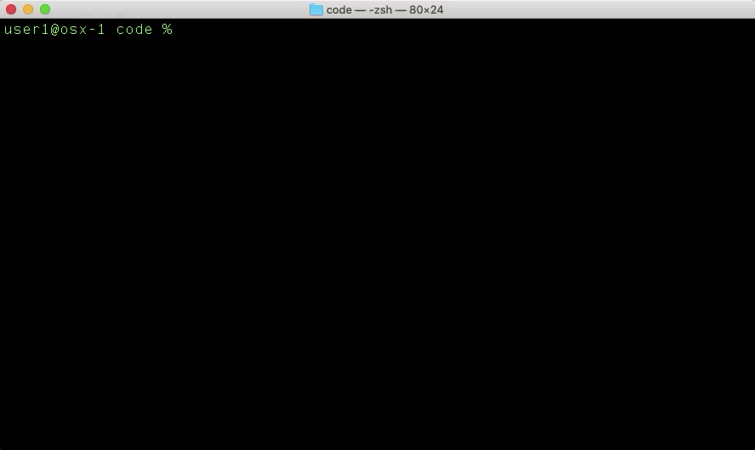
Notes:
Back in our terminal window, let’s run those commands.
We create the container and see that our prompt changes to /app.
Next, although you don’t see the key sequence on the screen, we press control, p, and q to exit the interactive session with the Container.
Last, we list our Container inventory.
We see the Container ID that Docker generates for the Container.
The name of the Image that produced the Container.
The result of the CMD instruction from our Dockerfile.
How long it’s been since we created the Container.
The status of the container, Up, in this case.
Any port numbers and protocols from the EXPOSE instruction in our Dockerfile.
Notice how this Container thinks it is listening on TCP 8080 even though we didn’t actually publish that port with the -p flag.
It’s up to whomever runs a Container from this Image to publish the port, the EXPOSE instruction just tells the Container creator which ports they should publish.
Finally, we see the name that we assigned to the Container.
Moving on…

Slide 51
Attach to a Running Container
List your Docker Containers
docker container ls -a
Attach to your running Container
docker container attach my_cont
Locate the Python script in your Container
ls -l
Run the Python script in your Container
python my_script.py
Notes:
So how do we get back to the Container shell session, so we can do something inside of the Container?
We need to know either the Container Name or Container ID that we want to attach to and we can find that with the docker container ls -a command.
Next, enter the command docker container attach followed by either Container Name or Container ID; it’s up to you.
Once you are back at the Container prompt, locate the Python script that we told Docker to copy to the Image during the build process with the command ls –l.
You can run the script with the command python my_script.py.
The script serves no purpose other than to show you that we can interact with scripts, binaries, and anything else inside the Container.
Imagine you need to run this script in the exact same build environment that the original developer used to create the script.
If the script creator did their work in a Docker Container, they could share the source Image with you and you can spin-up an exact copy of their environment.
Let’s run these commands in our terminal.

Slide 52

Notes:
First, we list our Container inventory with the command docker container ls -a so we can find the name of the Container we want to attach to.
Easy for us, given that we only have one container.
Now the command docker container attach my_cont will re-attach us to our Docker shell session.
We locate our script file with the command ls -a.
And have a little fun running our very simple Python script with the command python my_script.py.
Let’s move on to stopping and starting Containers.

Slide 53
Stop a Running Container
Exit interactive terminal mode with the escape key sequence
control + p + q
List your Docker Containers
docker container ls -a
Stop your running Container
docker container stop my_cont
List your Docker Containers again, to observe the new Container state
docker container ls -a
Notes:
This syntax is very similar to what we used to attach to our container.
If you haven’t done so already, use the control + p + q key sequence to return to your terminal prompt.
If you need to, use the command docker container ls -a to find the name or ID for your Container.
Enter the command docker container stop followed by the name or ID of your Container.
And, once more, list your Containers with the command docker container ls -a and check out the state of your Container.
Let’s do it.

Slide 54
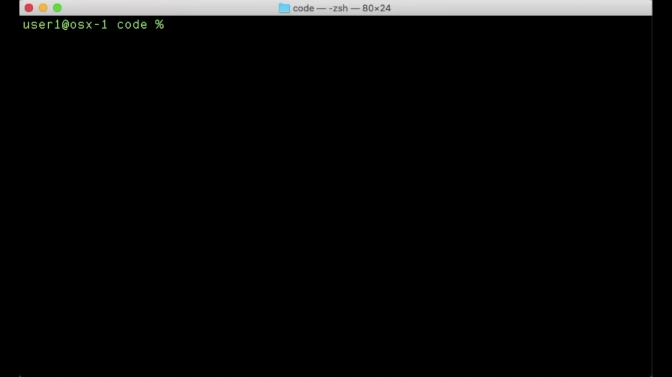
Notes:
We start out at our Docker Host terminal prompt, already having issued the control + p + q escape sequence.
We list our Containers with the docker container ls -a command and see our Container name and ID.
Now enter the command docker container stop my_cont.
Sometimes it takes several seconds but Docker will eventually output either the Container name or ID to indicate it performed the stop action.
When we rerun the docker container ls -a command we can see the state now shows an Exited state and tells us how long the Container has been in that state.
If we need to start that Container back up, we have an easy way to do that too.

Slide 55
Start a Stopped Container
List your Docker Containers
docker container ls -a
Start your stopped Container
docker container start my_cont
List your Docker Containers again, to observe the new Container state
docker container ls -a
Notes:
Once again, the syntax is very similar to what we used to attach to and stop our container.
Use the command docker container ls -a to find the name or ID of the Container you want to start.
Enter the command docker container start followed by the name or ID of your Container.
List your Containers with the docker container ls -a command and check out the state of your Container.
Back to the terminal…

Slide 56

Notes:
List your Containers with the docker container ls -a command and find the name or ID of the Container you want to start.
Enter the command docker container start my_cont.
Again, this may take several seconds but Docker will eventually output either the Container name or ID to indicate it performed the stop action.
Rerun the docker container ls -a command and notice the state now shows an Up.
If you wanted to work within this Container, you could use the docker container attach command and be right back in the Container prompt.
It’s easy to get rid of Containers that we no longer want so let’s go through how that works.

Slide 57
Remove a Container
List your Docker Containers
docker container ls -a
Stop your running Container
docker container stop my_cont
Remove your stopped Container
docker container rm my_cont
List your Docker Containers again, to see the result of the removal
docker container ls -a
Notes:
The syntax to remove a Container is just about like attaching, stopping, and starting a Container.
Use the command docker container ls -a to find the name or ID of the Container you want to remove.
If that Container isn’t already stopped, sop it with the docker container stop command, followed by the name or ID of your Container.
Remove the container with the command docker container rm and the name or ID of your Container.
Use the docker container ls -a command to confirm that your Container no longer exists.
Let’s make it happen…

Slide 58
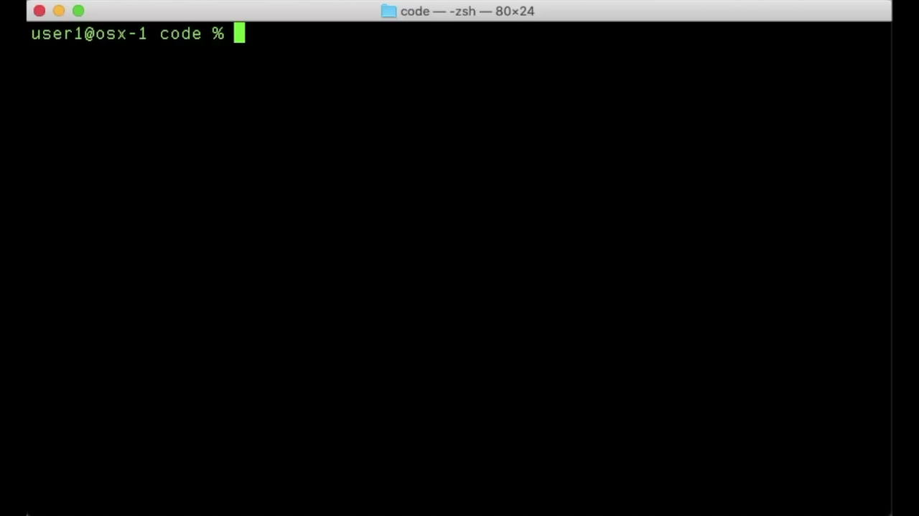
Notes:
First, list Containers with the docker container ls -a command, take note of the Container name or ID, and notice the Container is in an Up state.
You need to stop the Container before you remove the Container or Docker will give you an error message to remind you.
Stop the Container with the command docker container stop my_cont.
After Docker outpus the Container name or ID, remove the container with the docker container rm my_cont command.
Rerun docker container ls -a and notice the Container no longer appears in the list.
There is one more Container topic for us to cover so let’s finish things up.

Slide 59
Create a Docker Container With a Mapped Volume
Create a new directory and file on your host computer
mkdir my_dir
cd my_dir
vi my_file
Press i to insert text, type some text, press escape
Type :x and press Enter/Return to save and exit
Use your Docker Image to create a Docker Container
docker container run -itv $PWD:/app/files --name my_cont my_image
Observe the mapped volume in your Container
ls -l
cd files
cat my_file
Notes:
It’s pretty common to need to map a volume on your Docker Host to a Docker Container so we’ll walk through an example of how to do that and what it looks like when you’re done. Here’s what we will do:
Use the mkdir command to create a new directory on your Docker Host.
In this case we name the directory my_dir.
Use the cd command to change to the new, my_dir directory.
Create a file with VIM using the command vi my_file, this will open VIM with a blank, new file.
If you don’t have experience with VIM, the command syntax can be a bit cryptic but we will walk through a few commands and make this simple.
Press the i key to start insert mode and type any line of text that sounds interesting to you.
When you’re done typing, press escape, type :x and press your Enter or Return key.
This will save your changes and close the file.
Now we will create a Container using the -v flag in order to make the contents of our new folder available to the Container.
The command we will use is docker container run -itv $PWD:/app/files --name my_cont my_image
Most everything in this command is familiar but let’s go through the v flag in more detail.
Between the v and --name flags are the source and destination volumes.
The $PWD on the left side of the colon represents the source volume and $PWD is just Unix/Linux shorthand for the absolute path to your current working directory.
For fun, you can type echo $PWD at your terminal prompt and see the resulting output.
The /app/files on the right side of the colon is the destination volume; the location in the Container we map our source volume to.
Docker is smart enough to create the /app/files folder if it doesn’t already exist.
After you enter this command, you will be back at the /app prompt of your Container.
From here, let’s check out the file system to see if the volume mapping works correctly:
Type ls -l to list the files and folders in your working directory – you should see a folder called files.
Type cd files to change into the files directory.
Finally, type cat my_file to view the contents of the file – you should see the text that you typed in the file you created.
This whole exercise is just to show that you can have shared access to a file system between your Docker Host and your Docker Containers.
If you make any changes to the text file or do anything else to the file system within the Container, you will see the changes on your Docker Host file system.
The reverse is true too.
This is just one example of the many ways you can use Docker Volumes.
Let’s actually run this command in the terminal to see it in action.

Slide 60

Notes:
Start out with the mkdir my_dir command and then use the cd my_dir command to change into the my_dir folder.
Next, create a new text file in VIM with the command vi my_file.
Once VIM opens the new file, press i and type some text.
When you are done, press escape and type :x to save the file and return to your terminal.
Create a new Container with a mapped volume using the command docker container run -itv $PWD:/app/files --name my_cont my_image.
Once you see the /app prompt, your Container is ready.
Type ls -l and observe the files directory that Docker created when it launched this Container.
Type cd files and then ls -l again so you can see the my_file that we created on the Docker Host file system.
Type the command cat my_file and you will see the text from your file.
That wraps up Containers so let’s quickly cover some miscellaneous Docker topics before we wrap up.

Slide 61
Part V
Docker Quick Hits
Notes:
This section will show you a handful of topics that are good to know but that we won’t cover with as much detail as we went into with Images and Containers.
You are still welcome to follow along with your terminal or you can just watch the screen recordings if you prefer.

Slide 62
Docker Quick Hit Topics
Docker Exec
Docker Networks
Docker Compose
Cleaning Up
Notes:
The quick hit topics are:
Docker Exec
Docker Networks
Docker Compose
And Cleaning Up

Slide 63
Docker Exec
Run Container shell commands from the Docker Host terminal
Allows interaction with Containers without first attaching
docker exec [FLAGS] container_name command_to_run
docker exec -it my_cont pwd
docker exec -it my_cont ls -la
docker exec -it my_cont sh -c "cat /etc/*-release"
docker exec -it my_cont python my_script.py
Notes:
Docker Exec provides a way for you to interact with the shell of a Container from your Docker Host terminal.
This means you can run commands as if you were already attached to a Container shell without actually have to attach.
This is particularly handy if you need to run commands from the shells of several Containers.
It would be a huge pain to have to attach, detach, and repeat each time you want to run a command from a Container shell.
The syntax of the command is docker exec any flags we need, the name of the container, and the command to run.
Here are some Docker Exec examples:
docker exec -it my_cont pwd will output the working directory of the container named my_cont.
One quick note, the -it flags do the same thing in Docker Exec as they do in Docker Run.
docker exec -it my_cont ls -la will output a list of all regular and hidden files within the working directory of the container named my_cont.
docker exec -it my_cont sh -c "cat /etc/*-release" will output the contents of the Linux release file in the my_cont container.
This is a great way to see which Linux distrubition a given Container runs.
docker exec -it my_cont python my_script.py will use the Python interpretor in the my_cont container to execute the my_script.py file in the container.
Let’s go to our terminal and see how this looks.

Slide 64
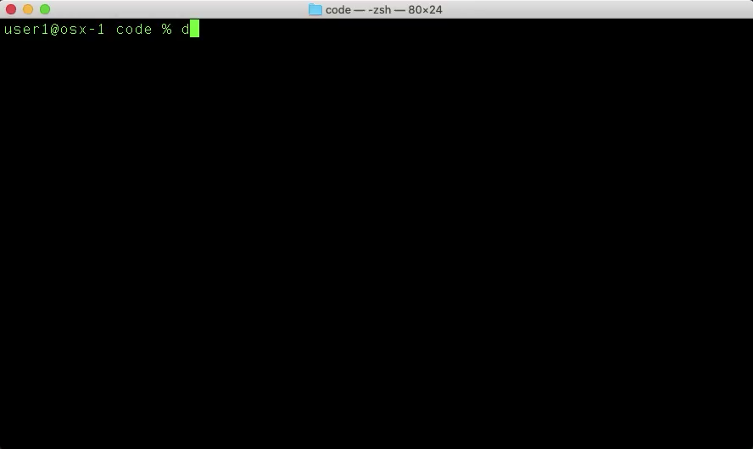
Notes:
Take note that all of these commands run from the Docker Host terminal prompt and NOT from the Container prompt.
First, we will check the name of the Container to run Exec commands on using docker container ls -l.
Next, the first Docker Exec command outputs the working directory for the Container.
The next command lists the files in the working directory for the Container.
The next command will show us the contents of the Linux release file for this Container.
And the last command will run our Python script using the Python interpreter in the Container.
On to the next quick hit topic…

Slide 65
Docker Networks
Enable communication between multiple Docker Containers
Isolate Docker applications to their own networks
Use automatic DNS to simplify Container connectivity
Notes:
Docker Networks are a very deep topic and we are only scratching the surface.
We will use Docker Networks to allow multiple Containers to communicate with each other on their own, isolated network.
It is a common practice to build multi-container applications with Docker and place all of those containers within their own Docker Network.
A neat feature of Docker Networks is auto-DNS which makes it really for us to connect Containers to each other without care about which IP address a given Container might pick up when it runs.

Slide 66
Deploy a Docker Network
Create a Docker Network and connect two Containers
docker network list
docker network inspect bridge
docker network create --driver bridge my_net
docker network list
docker network inspect my_net
docker container run -itd --net my_net --name my_cont1 my_image
docker container run -itd --network my_net --name my_cont2 my_image
Notes:
Here are the commands we will enter at the terminal – they span two slides:
docker network list will show us a list of the available Docker networks.
The name for one of those networks will be bridge and it’s a default network as part of the Docker installation.
docker network inspect bridge shows us details for the bridge network and we are specifically looking for the IP subnet.
docker network create --driver bridge my_net creates a new Docker Network named my_net using the Docker Bridge Network Driver.
docker network inspect my_net will show us, among other things, the IP subnet for our net network.
docker network run -itd --net my_net --name my_cont1 my_image will:
Create a new Container named my_cont1, based on the my_image image.
Run the Container in detached mode
And assign the container to the my_net network.
docker network run -itd --network my_net --name my_cont1 my_image will:
Do just about the same thing as the last command except the Container name will be my_cont2.
I used --network instead of --net for the sole purpose of showing that the two commands are interchangeable.
Moving to the next slide…

Slide 67
Deploy a Docker Network
Validate Docker Network connectivity
docker container ls -a
docker exec -it my_cont1 ifconfig eth0
docker exec -it my_cont2 ifconfig eth0
docker exec -it my_cont1 ping -c 4 my_cont2
docker exec -it my_cont2 ping -c 4 my_cont1
Notes:
We can validate that have two Containers that have the ability communicate using auto-DNS.
The docker container ls -a command shows us our two new Containers.
The docker exec -it my_cont1 ifconfig eth0 command shows us the IP address for my_cont1.
And docker exec -it my_cont2 ifconfig eth0 command shows us the IP address for my_cont2.
The docker exec -it my_cont1 ping -c 4 my_cont2 command will ping my_cont2 from my_cont1 and use auto-DNS to resolve hostnames to IP addresses.
This means it doesn’t matter which IP address my_cont2 has because Docker keeps track of the hostname to IP mapping and resolves addresses for Containers within the same network.
The docker exec -it my_cont2 ping -c 4 my_cont1 performs the same ping but from my_cont2 to my_cont1 this time.
Again, Docker will resolve the hostnames to IP addresses automatically.
Let’s see all of this in action.

Slide 68

Notes:
First we list our networks and see there are three available.
Next, we inspect the bridge network and determine the IP subjet is 172.17.0.0/16.
Now, we create our new network using the bridge driver and, afterwards, inspect the network to see the assigned IP subnet.
We see the subnet for our new network is 172.27.0.0/16 so all Containers in that network will get an IP address from that range.
Next, we create two new Containers and attach them to the my_net network.
Just like in the previous slides, we use a combination of the --net and --network flags just for show, because they are interchangeable.
We use docker container ls -l to see our two new Containers in an Up state.
It’s time to test out auto-DNS:
We look up the IP addresses for each my_cont1 and my_cont2.
We see my_cont1 has an IP address of 172.27.0.2 and my_cont2 has an IP address of 172.27.0.3.
Now, we use Docker Exec to ping from my_cont1 to my_cont2 and see that Docker successfully resolves my_cont2 to its IP address, 172.27.0.3.
And finally, we use Docker Exec to ping from my_cont2 to my_cont3 and see that Docker successfully resolves my_cont1 to its IP address, 172.27.0.2.
That’s it for Docker Networks, on to Docker Compose…

Slide 69
Docker Compose
Tool for building and running multi-Container Docker applications
Simple orchestration tool for Docker with YAML instructions
Single command to build/deploy or destroy multi-Container applications
Frequently used with CI/CD pipelines
Deploy pre-configured test environments
Run tests and provide results
Destroy test environments
Notes:
Docker Compose is a sweet tool that automates the standup and teardown of multiple containers, with a much simpler syntax than what we’ve been using in the Docker CLI.
Docker Compose read instructions from a YAML file which tell Docker to build Images and deploy Containers.
In the last section, we created two new Containers and attached them to a common Docker network but the syntax was pretty long.
It would be no fun to do all of that typing for 5 or even 10 containers and Docker Compose lets us do all of that with a single, simple command.
One of the more common use cases for Docker Compose is with CI/CD pipelines:
When someone checks code into a repository, a CI/CD tool can use Docker Compose to:
Spin up a new Container or set of Containers.
Run automated tests against the new code.
And then remove the Containers.
In this workflow, it’s not necessary to have Containers running all of the time and using resources.
Just bring the Containers up on-demand and get rid of them afterwards.
Let’s look at a simple, sample Docker Compose YAML file…

Slide 70
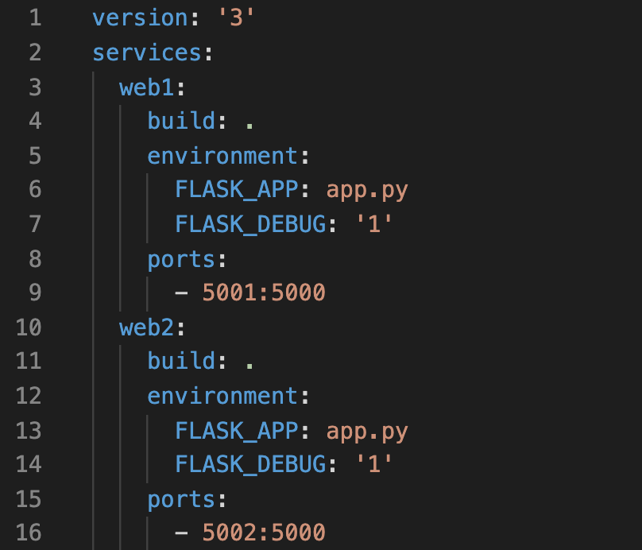
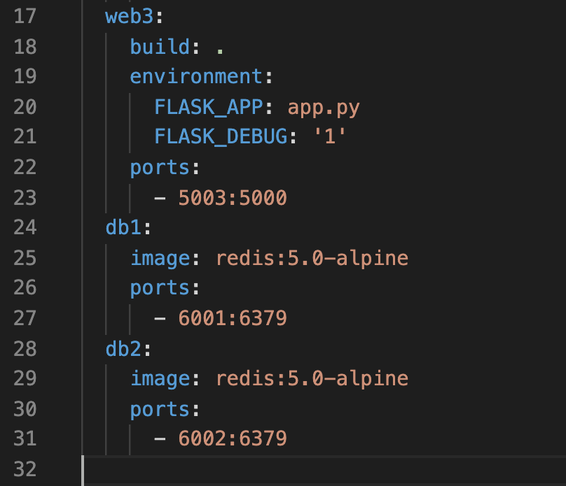
Example docker-compose.yml
Deploys 3 x web and 2 x database Containers with one command
Notes:
This Docker Compose file will deploy a total of 5 containers with a single command.
In this case, the resulting application isn’t real but it illustrates how Docker Compose works.
First, we define the services or Containers we want to deploy.
In our case we define three web server containers named web1, web2, and web3.
Notice the build key with a value of dot.
This tells Docker to build a Docker Image for the container using the Dockerfile in the same directory as the Docker Compose YAML file before it creates and runs each Container.
Also notice that each web server publishes a different host port to the same container port.
What this means is the Docker Host will forward any connections:
On port 5001 to port 5000 of the web1 container.
Port 5002 connections go to port 5000 of the web2 container.
And, you could probably guess this, port 5003 connections go to port 5000 of the web3 container.
Afterwards, we define two Redis database containers.
Since we don't have a build key for these containers, they will simply deploy from the redis:5.0-alpine Image.
If that Image isn't in the local registry, Docker Compose will download it from Docker Hub.

Slide 71
Docker Compose
Use Docker Compose to create/deploy and verify a five Container app
docker container ls -a
docker-compose up -d
docker container ls -a
curl http://localhost:5001
curl http://localhost:5002
curl http://localhost:5003
docker-compose down
docker container ls -a
Notes:
Let’s quickly review the CLI commands that we will use to bring this application online, verify it works, and take it down.
We will use docker container ls -a to check our Container inventory before we start.
Then we use the command docker-compose up -d to start the application.
The -d flag runs all of the containers in detached mode so we can use our terminal window to do some verification.
Once the Containers are up we can use docker container ls -a to look see the new Containers in our inventory.
To check that each web server is online and responding, use the commands.
curl http://localhost:5001
curl http://localhost:5002
And curl http://localhost:5003
We should get a response from each web server.
After verification, use the command docker-compose down to stop and remove the Containers associated with this application.
Check the Container inventory one last time with docker container ls -a.
Let’s see this in action…

Slide 72
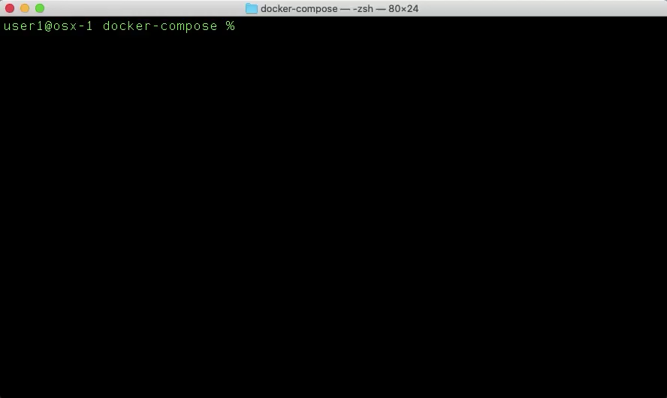
Notes:
When we check the Container inventory, we see that this particular Docker Host has no Containers; let’s change that.
The docker-compose up command starts out by building any Images using a Dockerfile.
If the Images were already built, Docker would skip this step.
Immediately after the Image builds are complete, Docker deploys all 5 of the Containers.
Now, we check the Container inventory again and see that we have 5 Containers, each with an Up status.
We use the curl tool to send an HTTP request to each of the published ports described in our YAML file.
Each server responds with the text Hello World which tells us that the servers are up and operationa.
When we finish testing, we remove the application with the docker-compose down command.
We can double-check that the Containers are no more with a quick check of the Container Inventory.
That’s it for Docker Compose, let’s move on to the last quick hit topic, how to clean up a Docker Host.

Slide 73
Cleaning Up
Notes:
We can assume that Docker Desktop uses some amount of resources on our computer so we will cover how you can keep track of and manage Docker’s resource usage.

Slide 74
Understand Docker Disk Usage
How much storage do Images, Containers, and Volumes use?
docker system df
docker system df -v
Notes:
There are a couple of commands which show you how much storage space your Images, Containers, and Volumes use:
The docker system df command gives you a basic summary of storage usage and adding the -v flag gives you detailed usage information for each Image, Container, and Volume.
Let’s check that out in our terminal.

Slide 75

Notes:
We can see that docker system df shows the total and active number of Images, Containers, and Volumes on the docker host plus the total disk space that each uses.
When we add the -v flag to the command, we see the amount of storage used by each individual item.
We need to scroll back a little bit to review all of the output.
We will come back to how we clean up Images, Containers, and Volumes that we no longer want shortly.

Slide 76
Stop All Running Containers
What is an easy way to stop all running Containers?
docker container stop $(docker container ls -q)
Notes:
Before we get into cleaning up I think it is helpful to know how to easily stop all running Containers; since we can’t delete Containers we don’t want if they are running.
The command docker container stop $(docker container ls –q).
Lists all of the running Containers and passes the output to the docker container stop command, one line at a time, with the -q or quiet flag.
This flag suppresses what is normally an excessive amount of text output.
Back to our terminal to see how this looks.

Slide 77

Notes:
A look at the Container inventory shows us a total of 8 running containers.
Instead of issuing 8 separate docker container stop commands, let’s use the one command we just discussed.
It may take several seconds to stop each Container and Docker will output the Container ID of each Container it stops.
Afterwards, we check the Container inventory again to see there are now no running containers.

Slide 78
Remove All Stopped Containers
What is an easy way to remove all stopped Containers?
docker container prune
Notes:
To remove all of our stopped containers, we use the command docker container prune.
Docker will ask you to confirm the action and then get rid of the stopped containers.
Let’s have a look…

Slide 79
Notes:
First, let’s quickly check the Container inventory.
There are plenty of stopped containers so let’s get rid of them.
After we enter docker container prune we see Docker ask us to make sure we really want to do this.
Once we type y and press Enter or Return, Docker does the rest.
We recheck the Container inventory and see there are no longer any Containers on this Docker Host.
Now that we cleaned up our Containers, let’s do some Image cleanup.

Slide 80
Remove Dangling Images
Dangling Images are those with <none> Repository and Tag values
What is an easy way to remove dangling Images?
docker image prune
Notes:
From time-to-time you will have dangling Images on your Docker Host.
When Docker Builds Images, it creates a temporary Image for each layer and attempts to delete the temporary Image after each layer completes the build process.
Sometimes, Docker can’t automatically delete those images so they appear in your Image inventory with the Repository and Tag value set to none <none>.
It’s easy enough to get rid of dangling Images.
Use the command docker image prune and they are gone.
Let’s try it out.

Slide 81

Notes:
First, we check the Image inventory and see that we have one Image, the second in the list of Images, with <none> values for the Repository and Tag.
It’s easy enough to remove one dangling image with docker image rm and the Image ID.
However, if you have a bunch of dangling Images, it’s easier to:
Type docker image prune.
Confirm with the y key.
And press the Enter or Return key.
Docker will do the rest and tell us how much space we reclaimed.
10.62 megabytes in this case.
When we recheck the Image inventory we no longer see any dangling images.
Lets do a bit of broad-scale Docker cleanup now.

Slide 82
Docker System Cleanup
How to easily remove all?
Dangling Images
Stopped Containers
Unused Networks
Build cache
docker system prune
Remove all of the above plus all unused Volumes:
docker system prune --volumes
Notes:
If we had to use individual commands, it would be a huge pain if we have to remove all of our:
Dangling Images.
Stopped Containers.
Unused Networks.
And Build Cache
Fortunately, we can use the docker system prune command and clean up all of those things at once.
If we want to clean up any unused Volumes along the way, we just add the --volumes flag to the command.
Let’s run the system prune commands and see how much space we can recover.

Slide 83

Notes:
First, let’s check our Docker system resource usage with the docker system df command.
There’s a bunch of stuff we can cleanup so let’s run docker system prune --volumes and see what the result is.
Docker will warn us about it will do once we confirm so let’s confirm.
Wow! Docker cleaned out 1.259 gigabytes of old stuff for us; not bad.
When we recheck our Docker system resource usage, we see everything is gone except 8 images.
For our last task of the presentation, let’s clean up those images.

Slide 84
Remove Unused Images
Unused Images are those which have no associated Containers
What is an easy way to remove unused Images?
docker image prune -a
Notes:
Docker considers any Image without at least one associated container to be unused.
Unused Images might be hogging up space on your Docker Host unnecessarily.
To get rid of unused Images, we use the same command we learned to clean up dangling Images except we add the -a flag to tell Docker to remove all dangling and unused Images.
Let’s run this final command and clean up the rest of our Docker Host.

Slide 85

Notes:
Before we clean up our Images, let’s see what we have in our inventory.
We still have a bunch of Images so let’s get rid of anything that isn’t in use with the docker system prune -a command.
Docker will, again, remind us of what we are about to do and ask us to confirm that we really want to continue.
When we confirm, Docker gets to work.
Those Images must have been unused because we can see Docker recovered 2.562 gigabytes of storage space.
When we take one last look at our Image inventory we see there are no remaining Images.
Docker is squeaky clean and ready for our next project.
That’s enough learning for today. Let’s wrap-up.

Slide 86
Part VI
Quiz & References
Notes:
To close things out, I want to give you a quiz to check your learning plus a list of all of the resources I used to develop the material; in case you want to do more research on your own

Slide 87


Docker Quiz
https://wwt.github.io/docker-foundations/docker-quiz
Notes:
You can find a quiz here and I hope you think all of the questions are easy to answer now that you’ve been through this presentation.
If you are new to Docker, this was a lot of material so thanks for sticking with me. You’re just took a big step away from being a CONE!

Slide 88
References
https://docs.docker.com/install
https://docs.docker.com/engine/docker-overview
https://docs.docker.com/engine/reference/builder
https://docs.docker.com/engine/reference/commandline
https://docs.docker.com/network/
https://docs.docker.com/compose
https://en.wikipedia.org/wiki/Docker_%28software%29
https://en.wikipedia.org/wiki/OS-level_virtualization
https://diveintodocker.com – paid instructional course
Notes:
As promised, this is all of the material I used to build this course.
Much of what I know is the result of the course I purchased from diveintodocker.com. The material is fantastic and the instructor Nick Janetakis does a brilliant job of delivering the material.
At the time I write this, the course if $49 and it’s a great investment to learn a lot about Docker.

Slide 89
Notes:
Thanks very much for your time. I welcome any feedback you would like to share whether it’s a comment, correction, pull request on the GitHub repo, or anything else.
I wish you success with your Docker learning journey!

